Slide 1
Software Process Models
Zeeshan Ali Rana

Slide 2
Recap
Software Process
Framework activities
Umbrella activities
Software Process Models
Lifecycle Models
Waterfall
Waterfall with Prototyping
V Model
Evolutionary
Prototyping

Slide 3

Spiral Model
Suggested by Boehm (1988)
Combines development activities with risk management to minimize and control risks
The model is presented as a spiral in which each iteration is represented by a circuit around four major activities
Plan
Determine goals, alternatives and constraints
Evaluate alternatives and risks
Develop and test

Slide 4
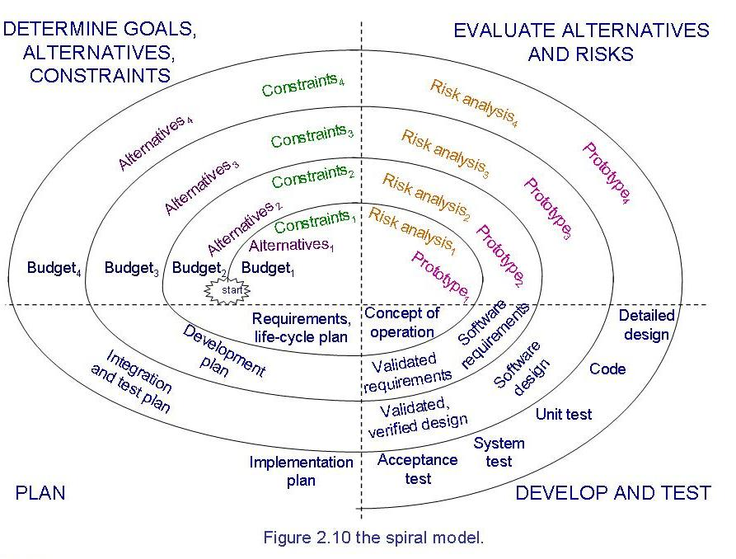
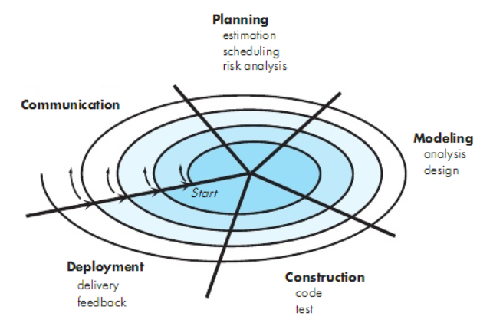
Spiral Model (Contd.)

Slide 5
Unified Process Model
Object-oriented system development methodology (system development process)
Offered by Rational/IBM, UP developed by Booch, Rumbaugh, and Jacobson
UP should be tailored to organizational and project needs
Highly iterative life cycle
Project will be use-case driven and modeled using UML

Slide 6
Unified Process Model (Contd.)
UP life cycle:
Includes four phases which consist of iterations
Iterations are “mini-projects”
Four Phases:
Inception – develop and refine system vision
Elaboration – define requirements and design and implement core architecture
Construction – continue design and implementation of routine, less risky parts
Transition – move the system into operational mode

Slide 7
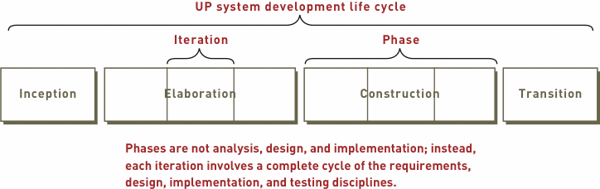
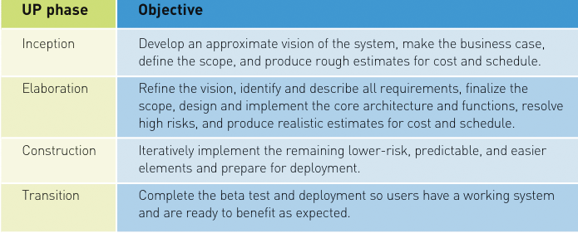
Unified Process Model (Contd.)
Images’ Source: Systems Analysis and Design in a Changing World, 4th Edition

Slide 8
Unified Process Model (Contd.)
Related development activities are called disciplines
UP disciplines:
Business modeling, requirements, design, implementation, testing, deployment, project management, configuration and change management, and environment
Each iteration includes activities from all disciplines
Activities in each discipline produce artefacts – models, documents, source code, and executables

Slide 9
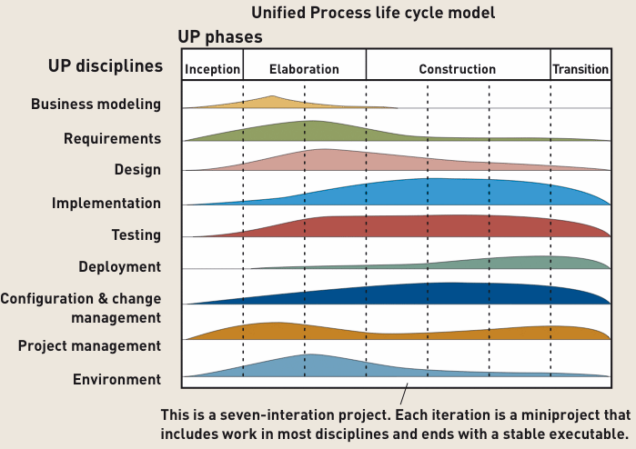
Unified Process Model (Contd.)
Image Source: Systems Analysis and Design in a Changing World, 4th Edition

Slide 10
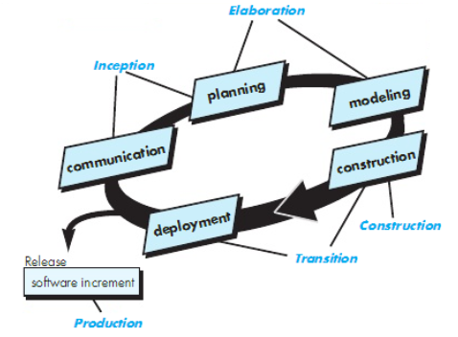
Unified Process Model (Contd.)

Slide 11
Phased Development
Cycle time
Time between when requirements document was written and when the system was delivered
Shorter cycle time
Decomposed system
System delivered in pieces
enables customers to have some functionality while the rest is being developed
Two systems functioning in parallel
the production system (release n): currently being used
the development system (release n+1): the next version

Slide 12
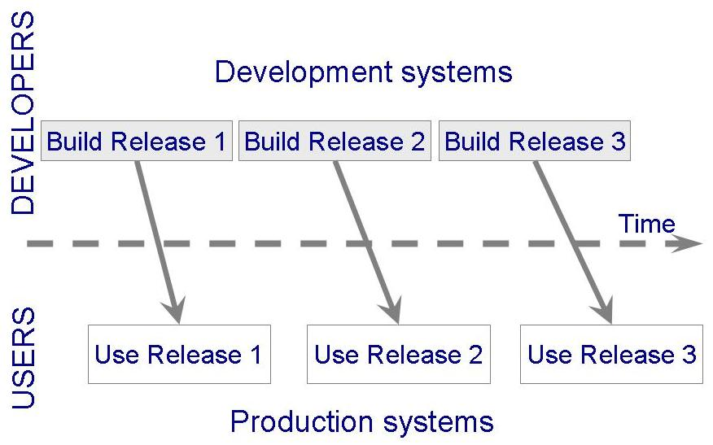
Phased Development (Contd.)

Slide 13

Phased Development (Contd.)
Incremental development: starts with small functional subsystem and adds functionality with each new release

Slide 14
Phased Development (Contd.)
Training on early release
Responsive developers
Markets for early functionality
Quick and Global fixing on unanticipated problems
Ability to work on different areas of expertise with different releases

Slide 15
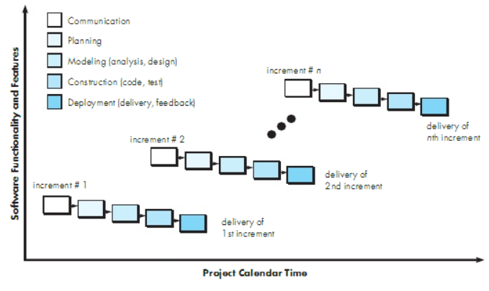
Models of Incremental Nature
Incremental Model

Slide 16
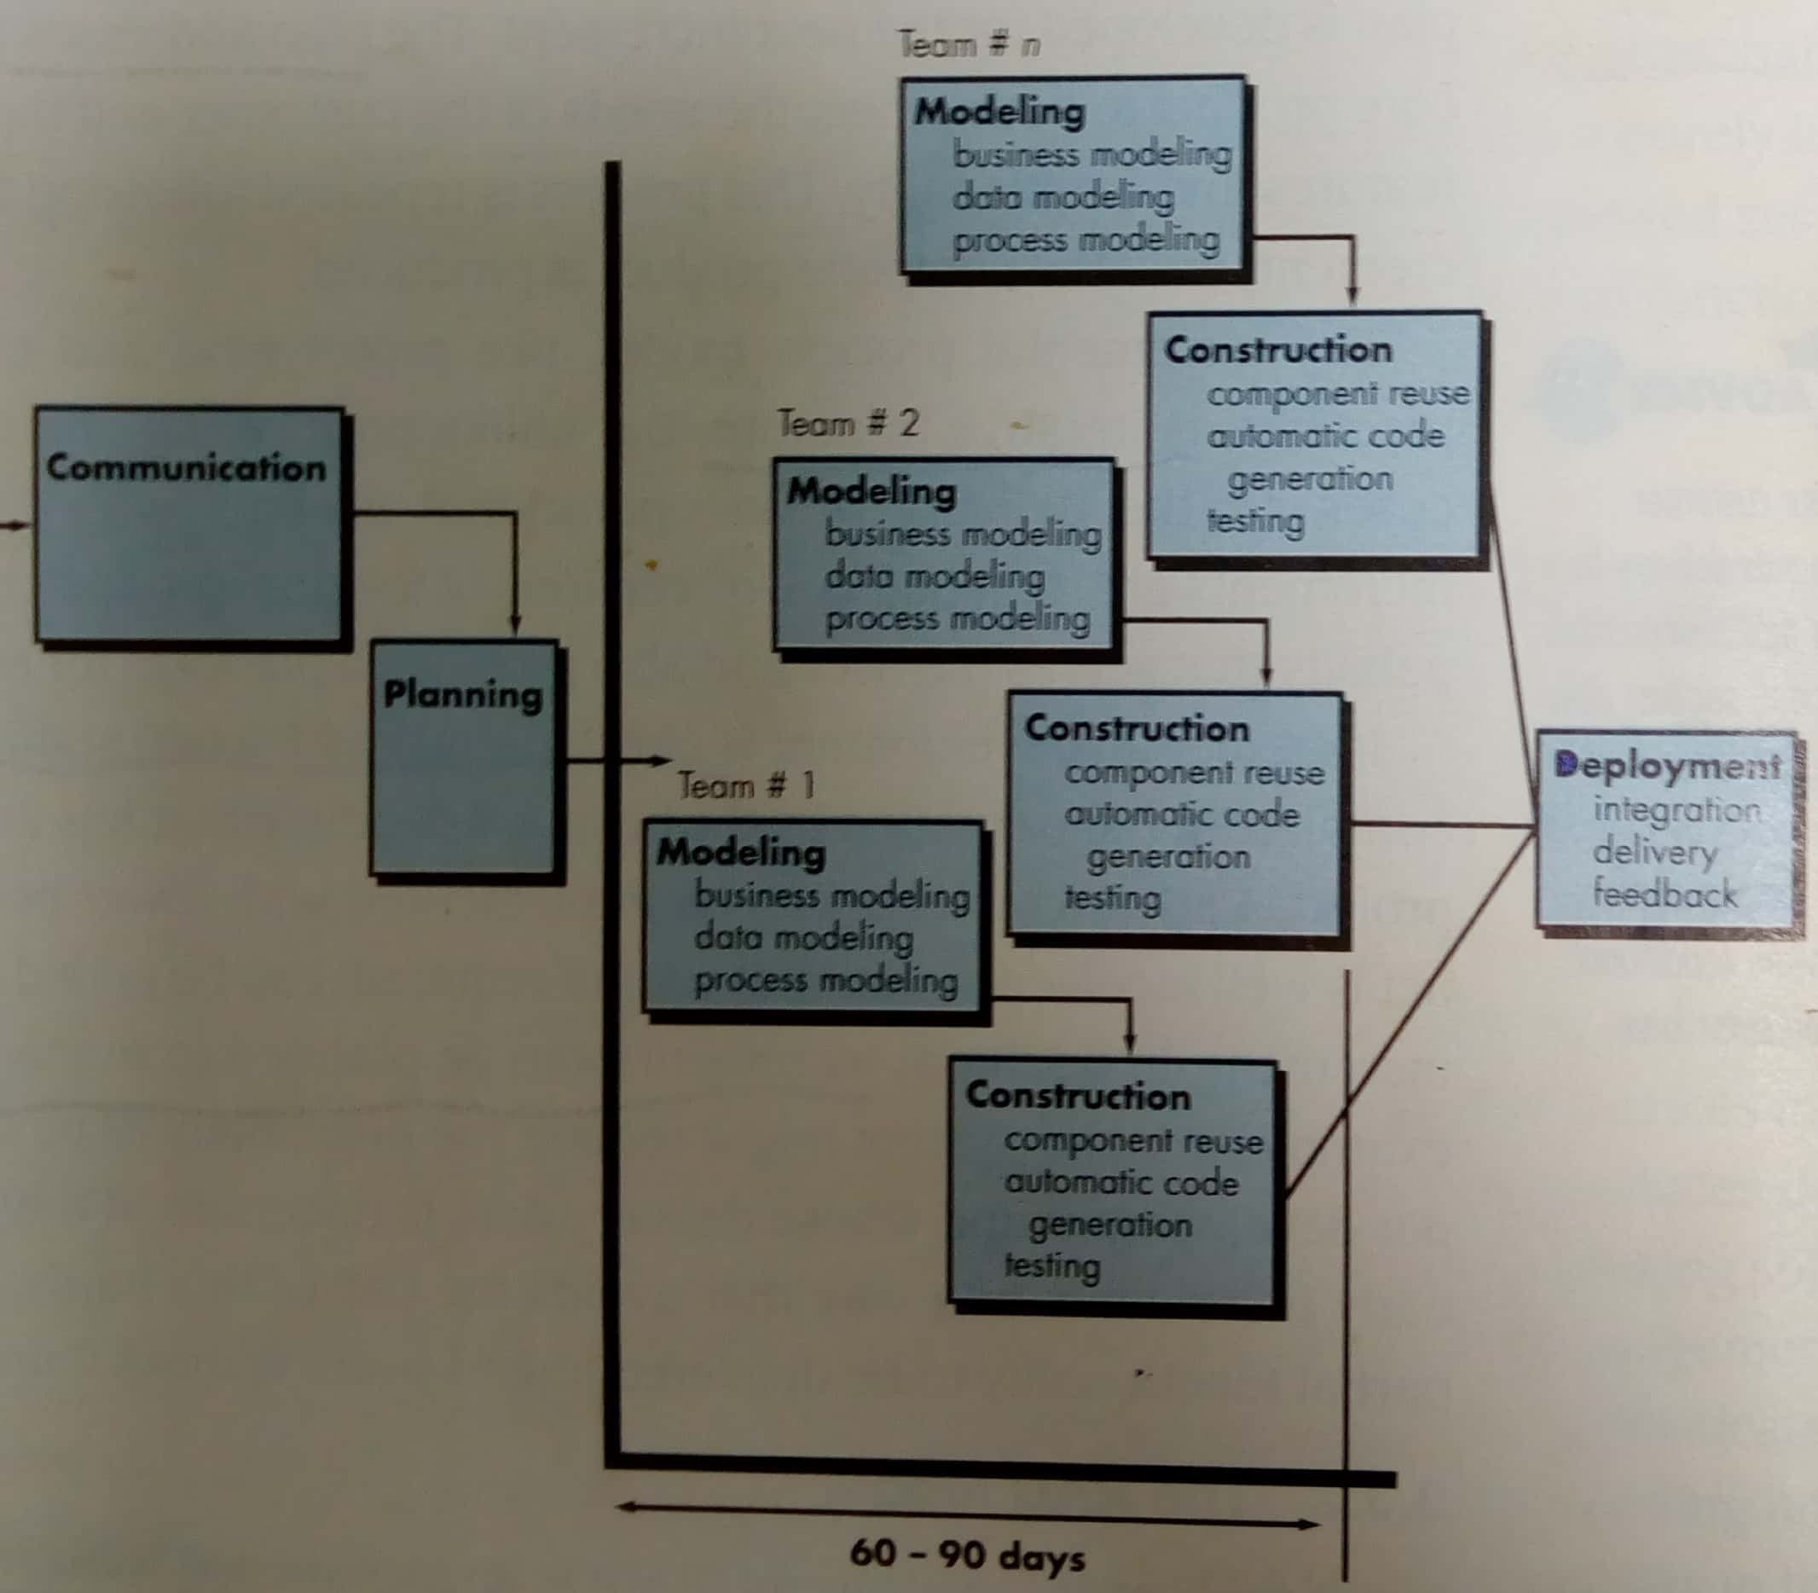
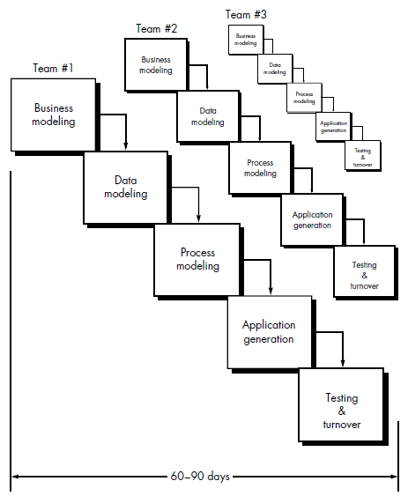
Rapid Application Development
Cycle Time?
Requirements? if not?
Resources? Teams? Scope?
Commitment?
Modular? If not?
High technical risks?
New app?
New technology?
Interoperability?

Slide 17
References
SE, Pressman
SE, Pfleeger

